Slide 1


Slide 2

Site Navigation
Principles

Slide 3


Slide 4
Stand Out!

Slide 5


Slide 6
Simple, Please!

Slide 7

“What in the world?.....”

Slide 8
Be Consistent!

Slide 9
Stay with the Familiar!

Slide 10


Slide 11
Be
Descriptive!

Slide 12


Slide 13
Get to the
Point!

Slide 14

Hmmmmm....

Slide 15
Be Interactive!

Slide 16


Slide 17
Have Order!

Slide 18


Slide 19
Have Some Style!

Slide 20
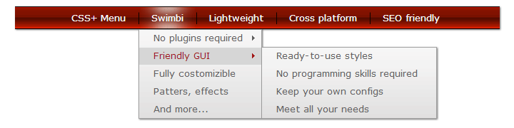
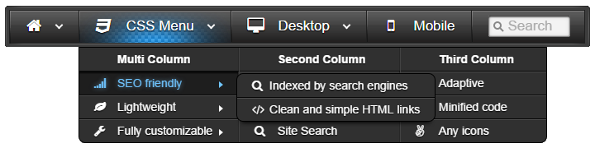
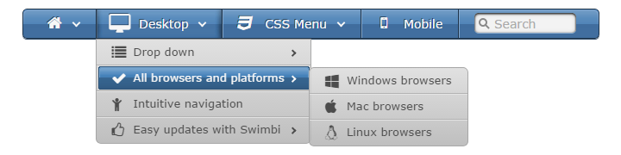
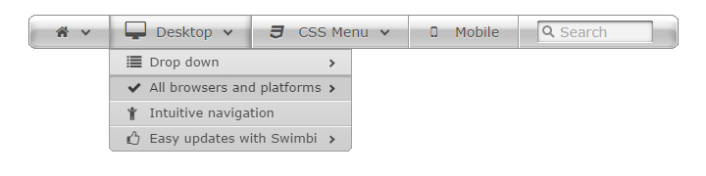
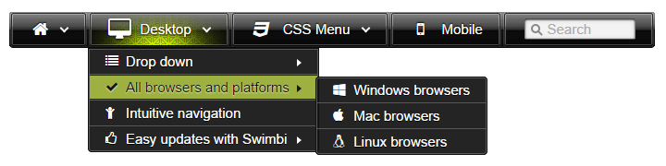
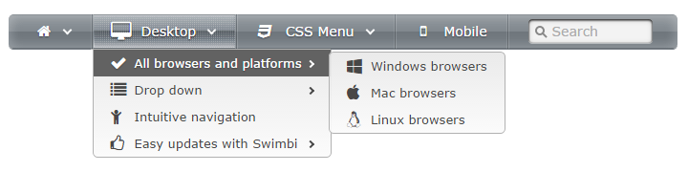

Slide 21
Silence!

Slide 22
Not too Deep!

Slide 23


Slide 24
Be Visual!

Slide 25
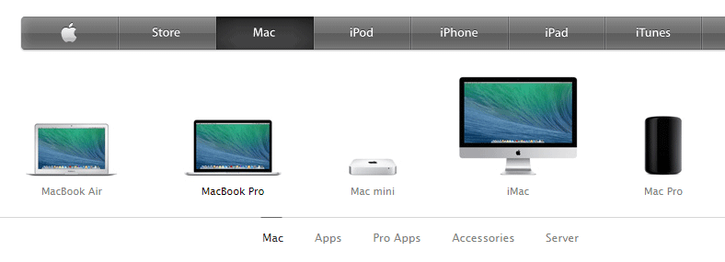

Slide 26
Be Animated!

Slide 27
Stay There!

Slide 28
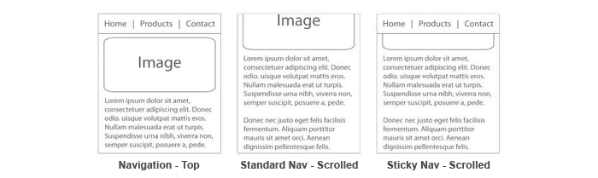

Slide 29
Be Scalable!

Slide 30


Slide 31
Test it!

Slide 32


Slide 33

Thanks for watching!

